Slide 1
PRESENTATION
THEORY
LABS
Aws Introduction
Virtualization
Models of cloud
Amazon Elastic Compute Cloud(ec2)
Linux Operating System
Linux /root Directory structure
Shell Scripting
Application Load balancer& net work load balancer
Auto-scaling and IAM(identity access management
VPC(virtual private cloud)
EBS(elastic block storage)
Launching EC2 instances(servers)
Creating AMI(amazon machine images)
Basic Linux Commands
If We Loss Key Pair How to Login Server By Using Amazon Machine Images
Shell Scripting
Application Load Balancer & network load balancer
IAM
VPC(virtual private cloud )
EBS(elastic block storage)

Slide 2
Aws Introduction
Aws (amazon web services) in this we have lot of remote computing services . We can find that services on website of “amazon.com”.
some examples: amazon ec2, elastic load balancing, amazon VPC, amazon elastic block storage.
Virtualization : Virtualization is the creation of a virtual -- rather than actual -- version of something.
Ex: operating systems, a server, a storage device or network resources.

Slide 3
Models of cloud
We have different types of cloud
1. Services models
2. deployment models
Service Models
1.IaaS(infrastructure as service) : provides the computing infrastructure and physical or virtual machines and other resources like load balancer, networks etc
Ex: amazon ec2, windows azure etc.
2.PaaS(platform as service) : provides computing platforms which typically includes operating system and programming languages execution environment, web server etc.
Ex: Aws elastic bean stalk, google app engine etc.
3.SaaS(software as service) : provided with access to application software’s often referred to as “on demand software”.
Ex: google apps Microsoft office
Deployment models
1.Private cloud
offered to select users over the internet or a private internal network
Provides greater security controls
2.Public cloud
Offered by third party providers
Available to anyone over the public internet
3.Hybrid cloud
Combination of both private and public cloud
Shared security responsibility
Helps to maintain tighter controls over sensitive data and process

Slide 4
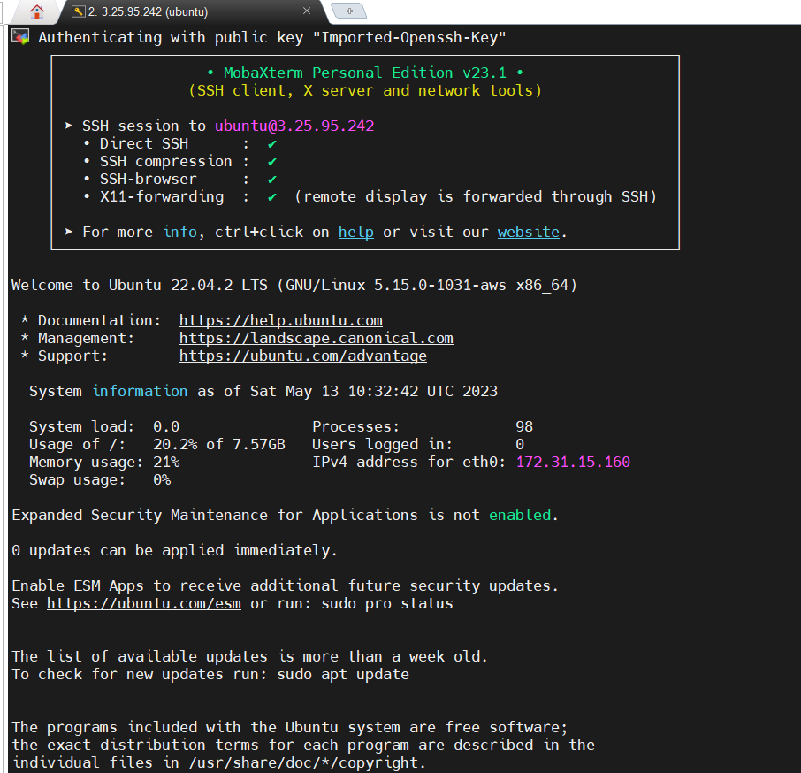
Amazon Elastic Compute Cloud(ec2)
Ec2 is one of the main service in amazon web services.
Features :
We can make our servers and we can make preconfigured templates for servers we call it as amazon machine images. And different types of configurations we can make. And networking capacity we call it as instance types ex : t2, t3 micro.
Ec2(elastic compute cloud):
https://docs.aws.amazon.com/AWSEC2/latest/UserGuide/concepts.html
Lab
Launching ec2 instances and connect to mobaxterm
Procedure
Go to amazon account and go to instances.
And click on launch instances .
Give name for instance and select any server and create a key pair then launch instance.
Next copy the public Ip address paste it in remote host in mobaxterm and give user name of selected server and go to advanced settings in that we have to give user private key then click on ok then you will login to the server.

Slide 5
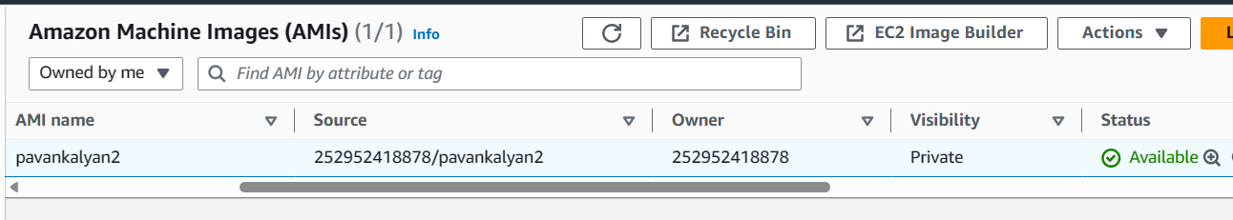
Creating AMI(amazon machine images) and connecting to the server if we loss keypair
Procedure
Launch a server
Select the server and go to the actions in that go for image and templates option
And click on create image
We have to give name and click on create image
Next go to my AMIs option and we can find our image is available
Next select that image go to the actions after that you will find edit AMI permissions option click on that where you will find add account id
Next add account id and click on share AMI
What if loss key pair
Create AMI for your running server and select it then click on launch instance with AMI
Where we have to give the name for server and we will create new key pair and click on launch instance
Next copy public Ip address of your instance go to mobaxterm and then sessions then “ssh protocol then paste Ip address in remote host give user name of server and go to advanced settings give user private key then click on ok
Now you will get your previous server with all the data that you have saved

Slide 6
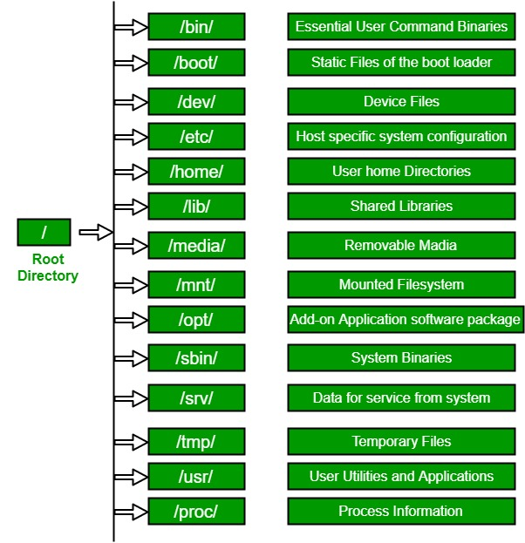
Linux Operating System
Linux is an operating system built by Linus Torvalds at the University of Helsinki in 1991. The name "Linux" comes from the Linux kernel. It is the software on a computer which enables applications and the users to access the devices on the computer to perform some specific function.
it is command line interface operating system. By using this we can install packages and we can make directories, files etc.

Slide 7
Basic commands in Linux
sudo su : used for changing to root user
pwd (present working directory) : used to know the location
mkdir directory name : use to create directory
touch filename : use to create Mt file
To create files in multiple ways
vi filename
echo “content” > filename
nano filename
cat > filename
ls : use to see the list of files and list of directories in server
ls –l: use to see detailed information of files or directories (like time and creation date)
rm filename : use to remove file
rm –r directory name : use to delete directory
mv : use to change filename
cp : use to copy file to current directory
find –type f –name filename : use to find files in the operating system
find –type d –name directory name : use to find directories in the operating system
chmod : use to give permissions to the file or directory
apt-get : use to install python, java etc
yum-get : use to install applications in mac operating system etc.
cd : use to change directory

Slide 8
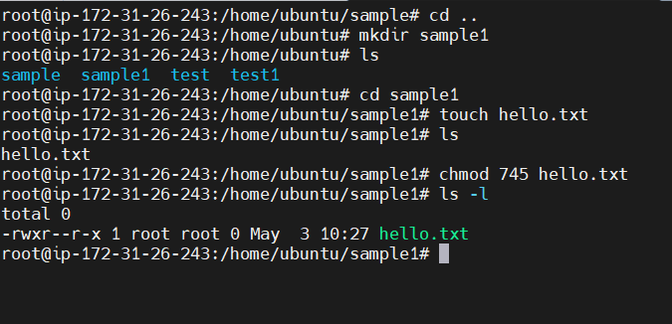
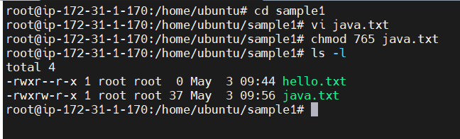
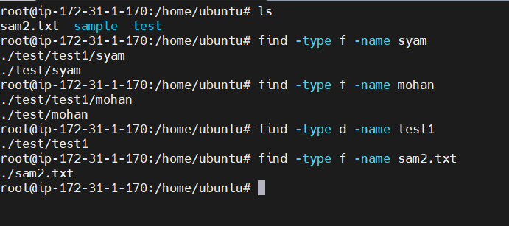
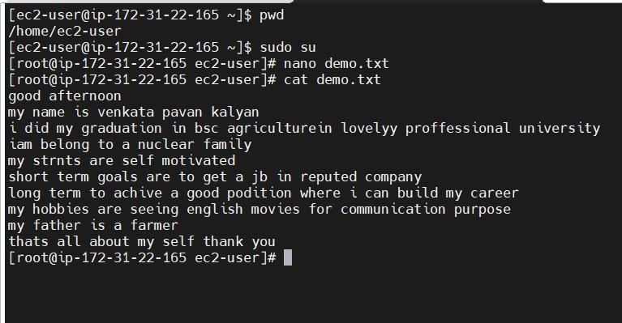
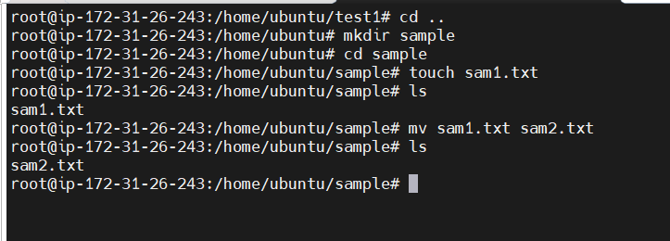
Lab on linux commands

Slide 9
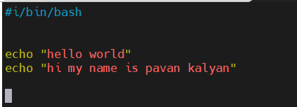
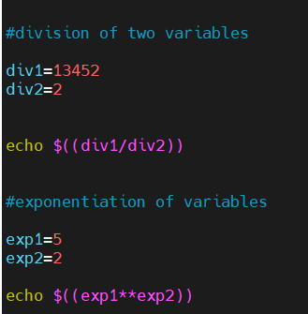
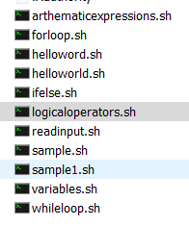
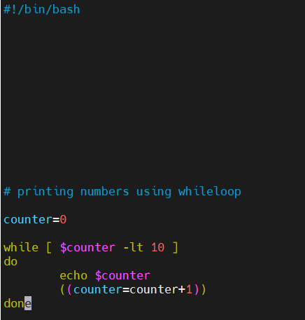
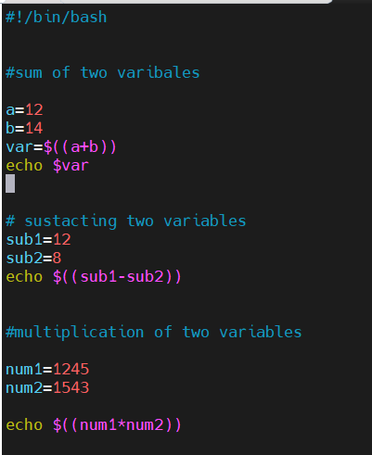
Shell scripting
A shell script is a list of commands in a computer program that is run by the Unix shell which is a command line interpreter.
A shell script usually has comments that describe the steps. The different operations performed by shell scripts are program execution, file manipulation and text printing.
Lab on shell scripting
These are the shell scripts made by me
while loop

Slide 10
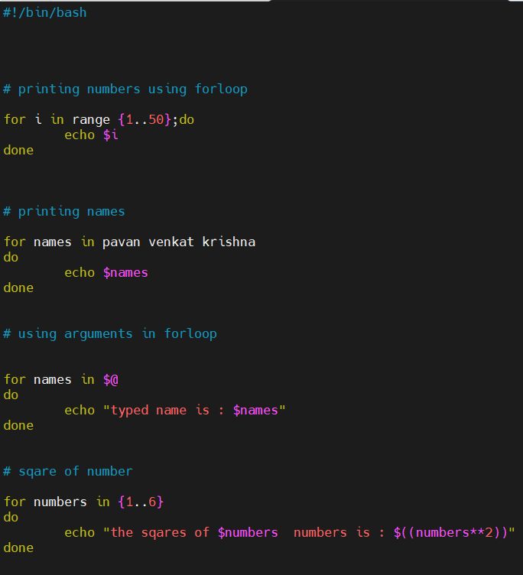
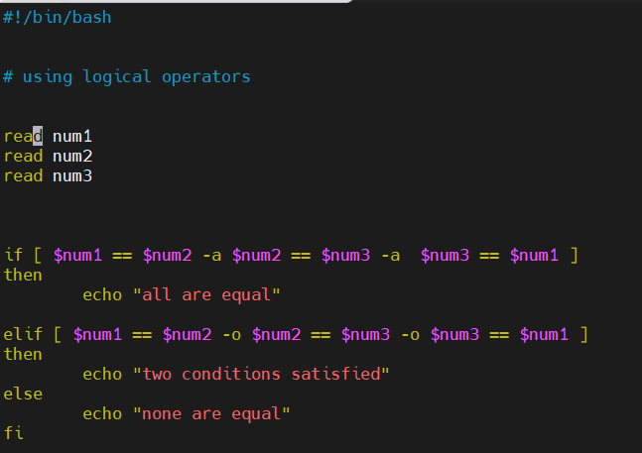
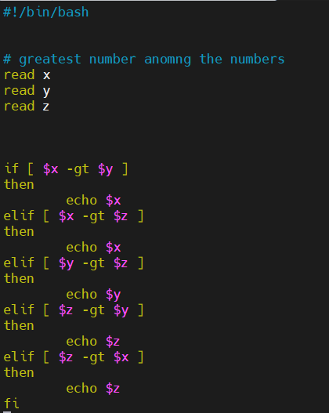
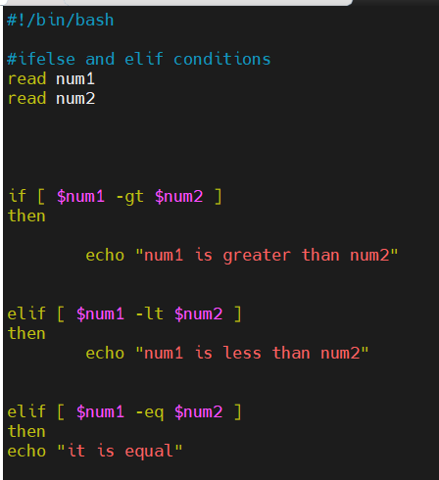
Foorloop script logical operators script
Greatest among numbers
Ifelse script
link for shell scripting
https://www.freecodecamp.org/news/shell-scripting-crash-course-how-to-write-bash-scripts-in-linux/

Slide 11
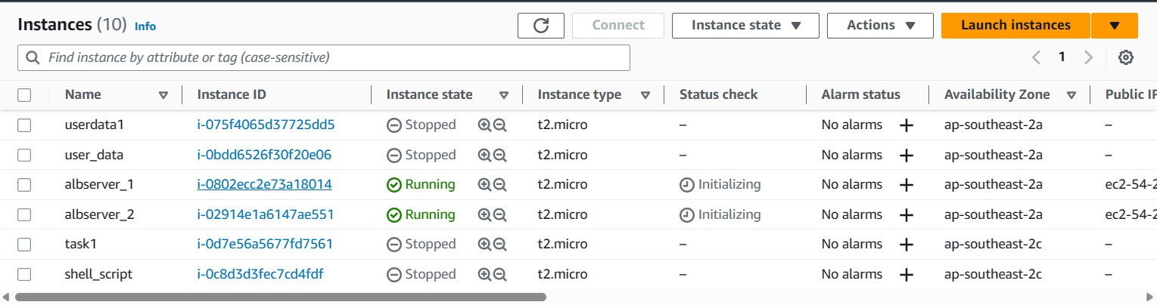
Application load balancer
Application load balancers is Layer 7 (HTTP)
Load balancing to multiple HTTP applications across machines (target groups)
Load balancing to multiple applications on the same machine (ex: containers)
Support for HTTP/2 and WebSocket
Support redirects (from HTTP to HTTPS for example)
Lab on application load balancer(ALB)
step1
We have to launch two instances
In that we have to allow all the traffic
And we have to give user data
Then launch

Slide 12
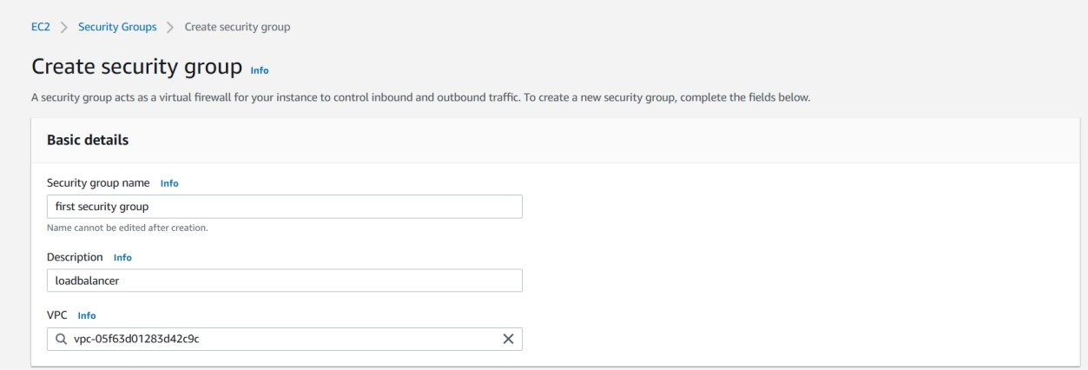
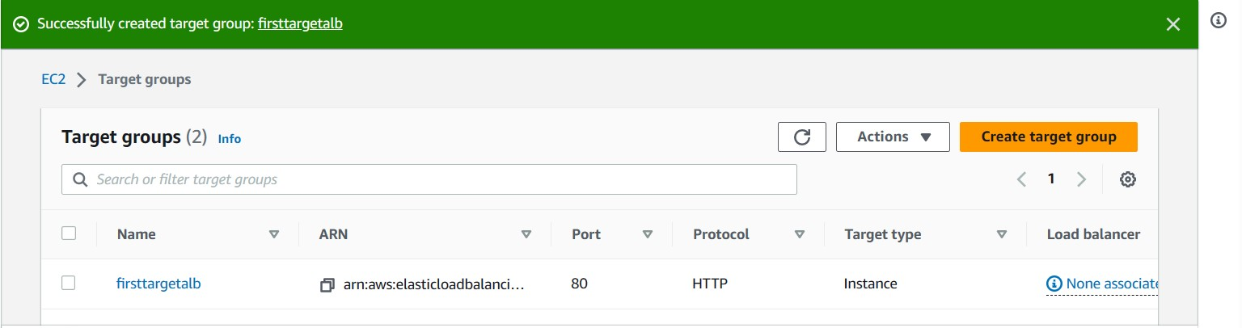
step2
In step2 we have to click on security group
And click on create security group
Give security group name and description
Next go to inbound rules in that you have to give HTTP type and destination we have to select anywhere
And add click on add rule in that you will give HTTPS type and destination anywhere
In outbound rules you will repeat same as inbound rules
And click on create security group
Step3
After creating security group we have to create target group
Click on target group
Scroll down and give name for target group name
And scroll down and click on next
After click on next we can see our two servers are running
And select both servers click on include as below option
Then the servers will add to target group
Then click on create target group
Now you are completed with target group creation

Slide 13
Step4
After creating target group we have to create load balancer
Click on load balancers
Next click on create load balancer
And go for application load balancer and click on create
After that you will give name for load balancer
Then scroll down you will see network mapping in that select all available zones
Next scroll down go for security group search for security group that you have already created and select it
Next scroll down go for listeners and routing here we have to give target group that we have already created
Next scroll down click on create load balancer
Step5
After creating all these (instances and security groups and target groups and load balancer)
Click on load balancers
Next select the load balancer that you have created
Next scroll down where you can see details of your load balancer
In details you have to copy DNS name
And paste it in the browser you will see output as shown in the picture below and refresh it and you will get another server user data

Slide 14
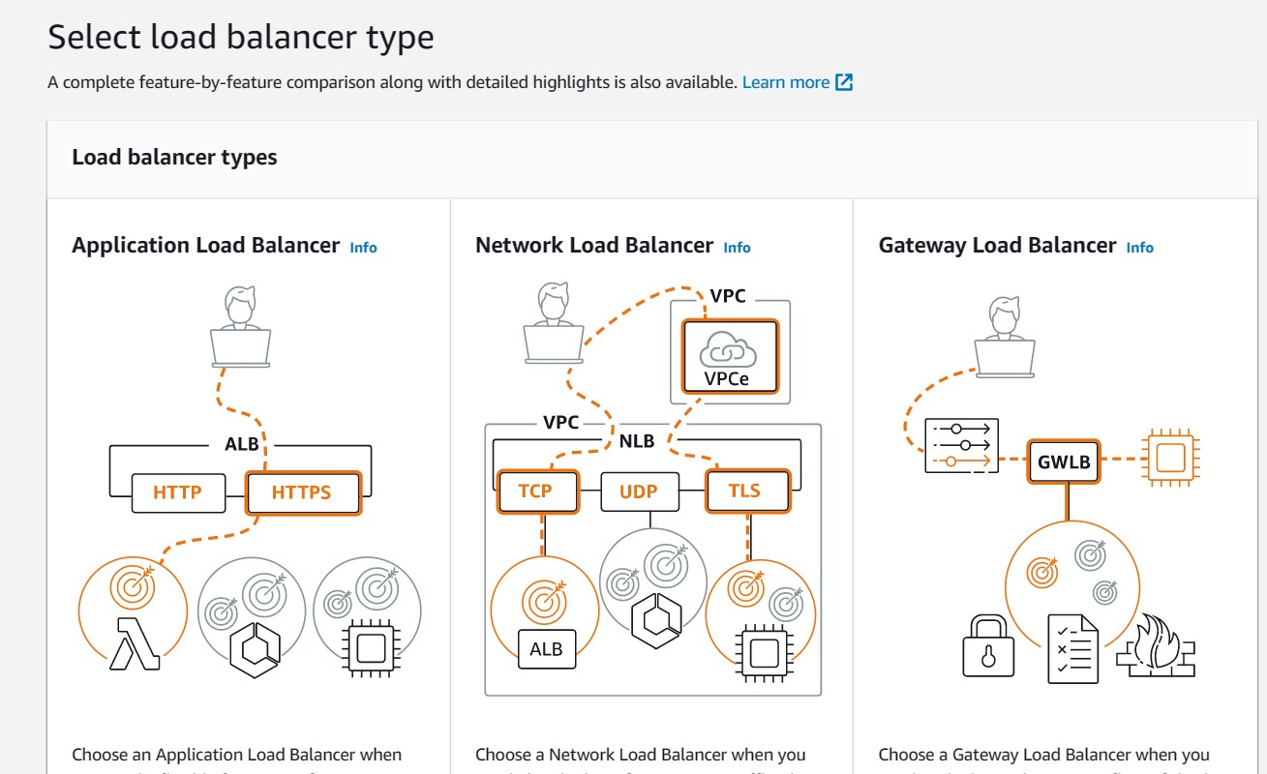
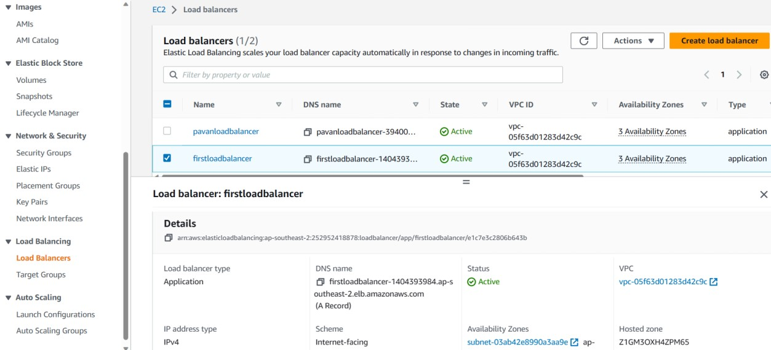
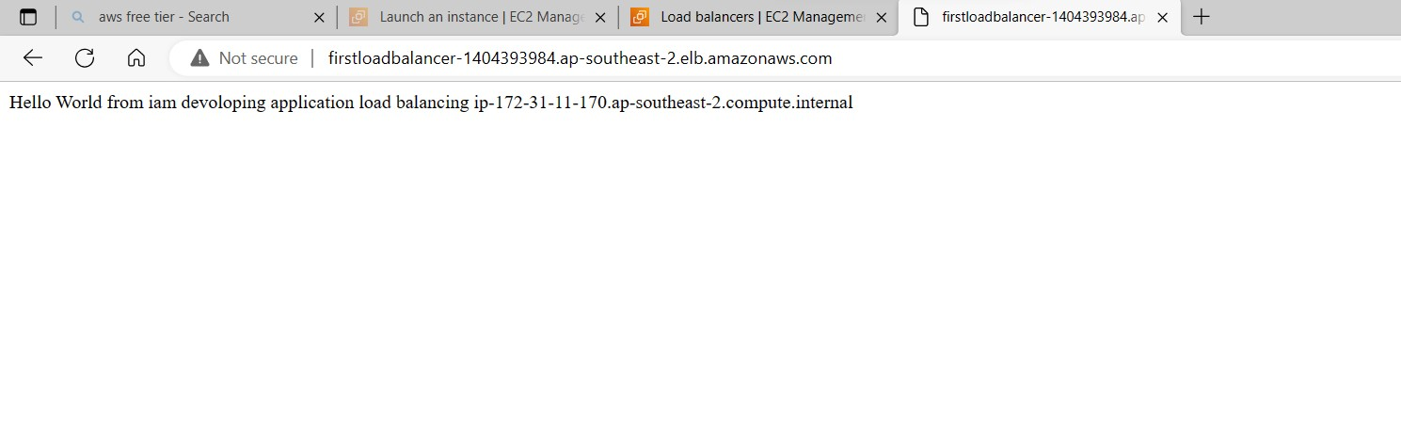
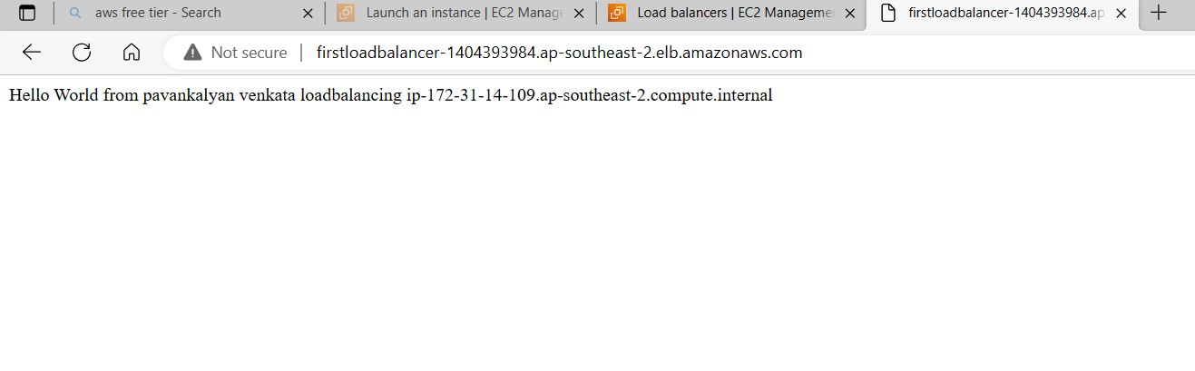

Slide 15
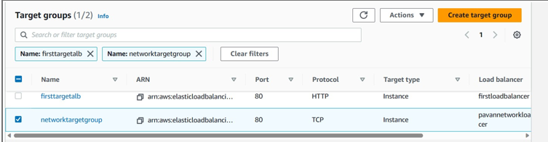
Net work load balancer
A Network Load Balancer (NLB) it works at 4th layer and it can handle TCP as well UDP protocols. It uses static IP addresses and can be assigned Elastic IPs—not possible with ALB and ELB. Its main feature is that it has a very high performance. NLB are used for extreme performance, TCP or UDP traffic
Lab on network load balancer
Step 1
We have to create two ec2 instances with user data
Step 2
In this we have to create one target group
We have to select both servers and click on include as pending below And click on create target group

Slide 16
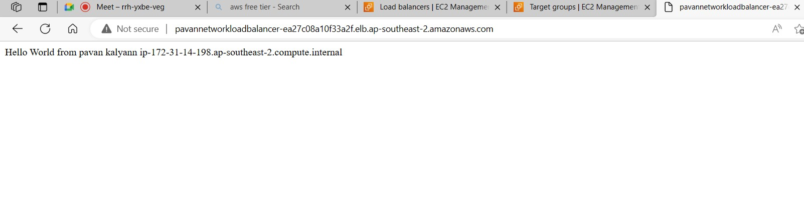
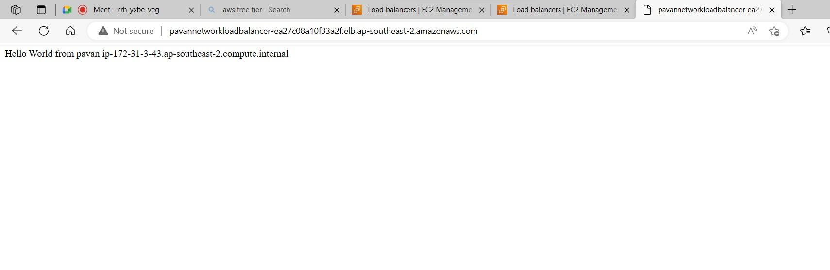
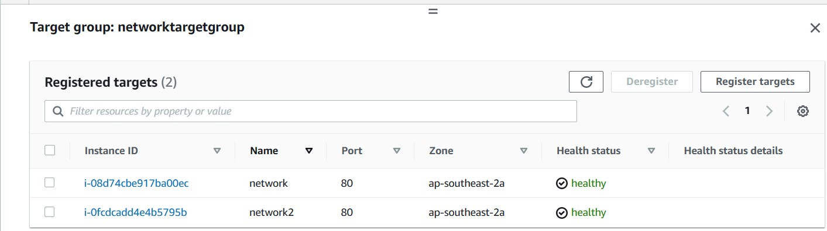
Step 3
Go for load balancer
Click on create load balancer
Select network load balancer we will give name there
And no need of security group
Then we have to give target group
Then click on create load balancer Wait until its get active
After that copy the DNS name of network load balancer
And paste in browser

Slide 17
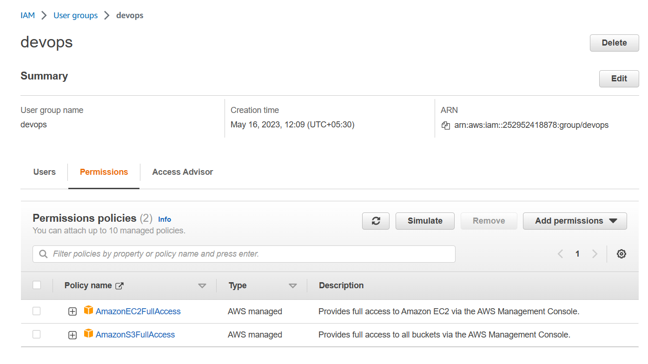
Auto scaling and identity access management
Auto scaling
IAM(identity access management
The auto scaling group always do monitor of our servers.
According to our configurations if a server is busy automatically it creates a new server according to our template settings in autoscaling group.
And automatically it can delete the server
It means we can control our AWS console .
We can give access of services like ec2 and s3 etc.
And we can create users and groups in IAM.
So that users or employees can log into our AWS console can use services whatever permissions we gave.
Link for identity access management
https://docs.aws.amazon.com/IAM/latest/UserGuide/introduction.html

Slide 18
VPC (virtual private cloud)
VPC it’s a virtual private cloud .
We can get secured private cloud hosted with in a public cloud
Customers they can run code and store data in the virtual private cloud but the VPC hosted remotely by a public cloud provider
NAT gateway
Public subnet
server 1
192.168.0.0/24
customers
Private subnet
Route table
Internet gateway
192.168.1.0/24
server 2
VPC
(192.168.0.0/16)
https://docs.aws.amazon.com/vpc/latest/userguide/how-it-works.html

Slide 19
Procedure for VPC lab first go to VPC service create VPC then create public subnet and private subnet then create internet gateway for public subnet NAT gate way for private subnet in that we will select through public subnet create route table in that there we can find local address and we have to select another route that is 0.0.0.0/0 ant where and select internet gate way another route table for private in that we gives NAT gate way then create two windows servers
and then connect to public server using RDP client
After connected we have to check it is pinging any websites or not
By using jumping method we will connect private server through public server
Go to terminal type mstsc enter the private Ip address of the private server
Give username and password Click on connect
After connected we have to check the private server is able to ping the google.com or something else
completed

Slide 20
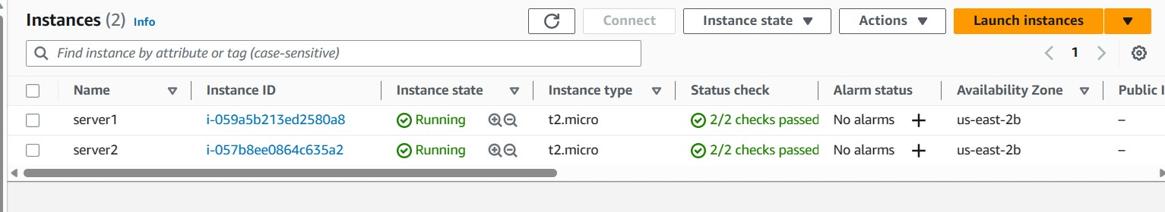
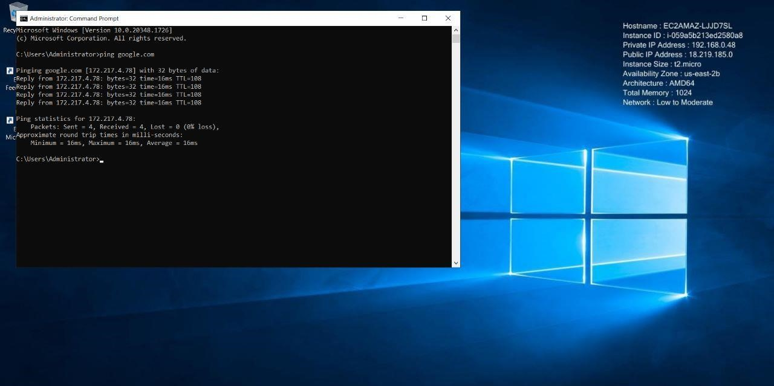
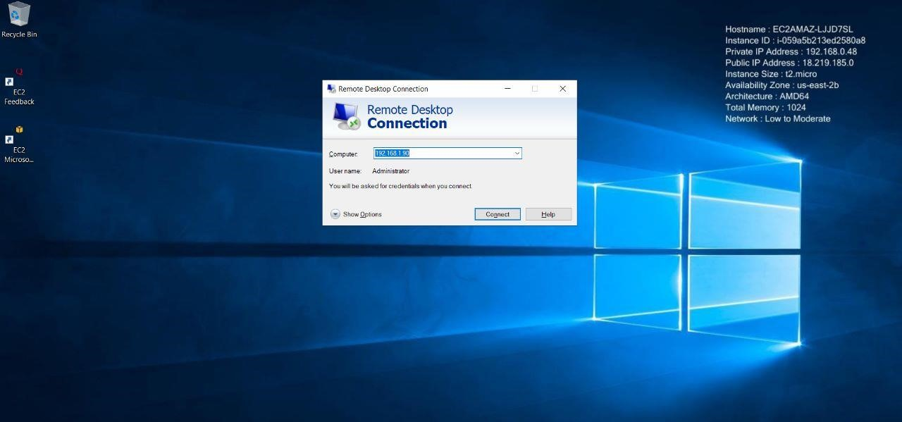
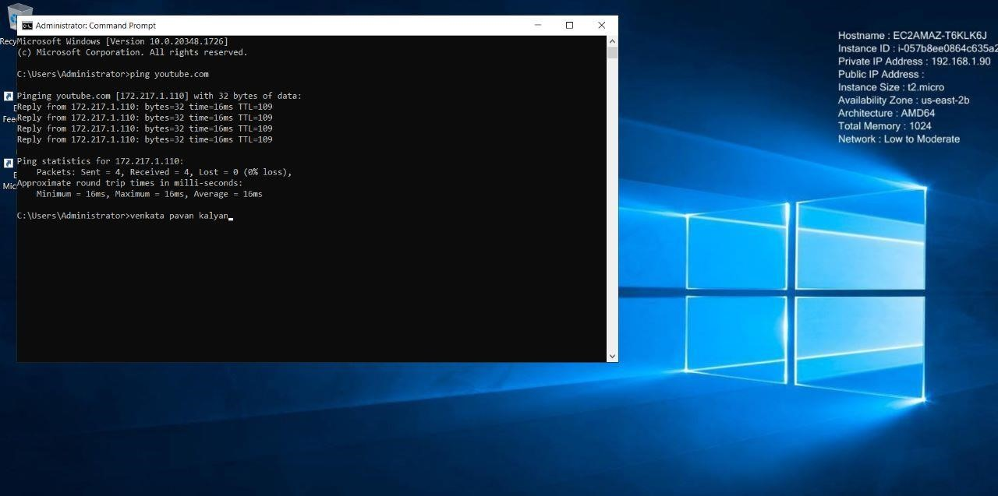
EBS (elastic block storage)
public cloud
EBS is a elastic service. By using this service we can create volumes for our servers . Thank you
And also we can share the volume of our servers to another customer by using snap shots so that they can use same volume for their server.
And we will connect to amazon Linux server where we can see volume of our servers by using commands.
sudo su : it is use to switch to root user
lsblk : it is use to the volumes of server
sudo mkfs –t ext3or ext4 /dev/xvdb : this command use to create file system in server
sudo mount /dev/xvdb/ directory name : this command mounts the directories in file system
jumping by using mstsc
private
Thank you..

